Slide 1

Team 24 – Project 2
Customer Shopping Analysis
Data Science Institute - University of Toronto

Slide 2

Team
Shiraz Latif, Jessilynn Kim, Mykhailo Vitvinov, Olena Bolokhonova

Slide 3
Contents
Project Introduction
Objectives & Scope
Project Retrospective
  Learnings in this project
  Challenges faced
  How we overcome those challenges
Future work
My Contributions

Slide 4
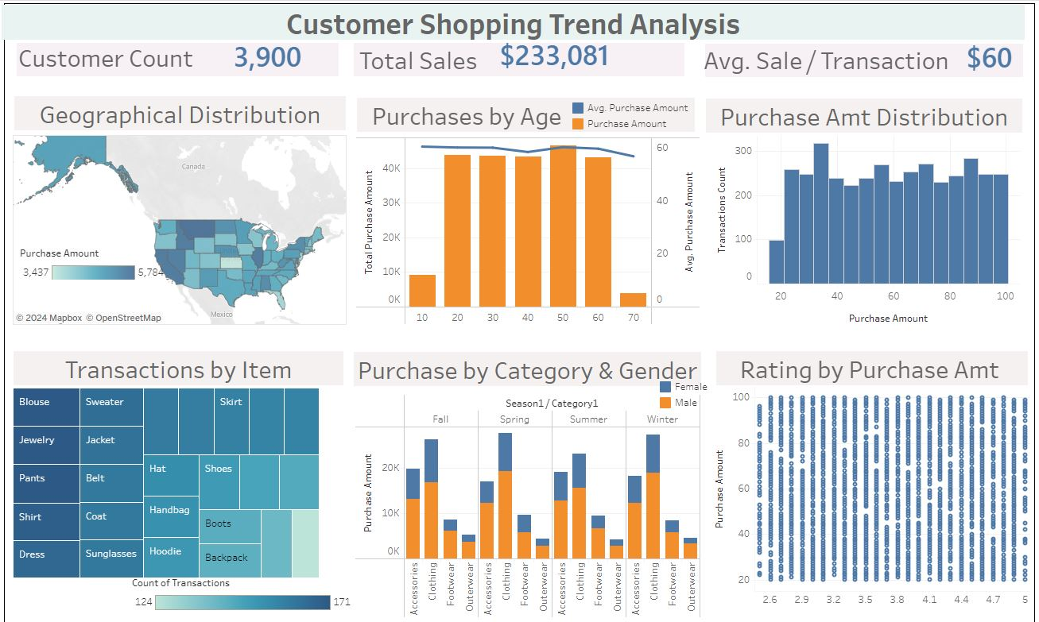
Introduction
Retail Customer Shopping Analysis
Data Source
  Chatgpt generated dataset
Fields
Customer ID
Age
Gender
Item Purchased
Category
Purchase Amount
Location
Size
Color
Season
Rating
Subscription Status
Payment Method
Shipping Type
Discount Applied
Promo Code Used
Previous Purchases
Preferred Payment Method
Frequency of Purchases

Slide 5
Objective & Scope
Objective:
  Generate insights from the dataset to help build strong marketing strategy
  Build accessible self-serve dashboard that help business user to generate real-time insights on regular intervals.
  Build a predictive model to predict a customer buying subscription.
Scope:
  Data Cleansing/ data preparation, if needed
  Exploratory Data Analysis for understanding trends and correlations
  Building visualizations in Python
  Building dashboard in Tableau
  Building dashboard in PowerBI

Slide 6
Journey of
Learning
Working in a Team
  Collaboration & Building Consensus
Framing Business Problem
Project Management
Python programming
Data Analysis
  Identifying Trends & Patterns in the data
  Exploratory Data Analysis
  Regression model development and assessment
  kNN classification model
Git & Version control
  Working with branches and commits
  Pull Request, Approval process
  Resolving conflicts in merge
Data Visualization

Slide 7
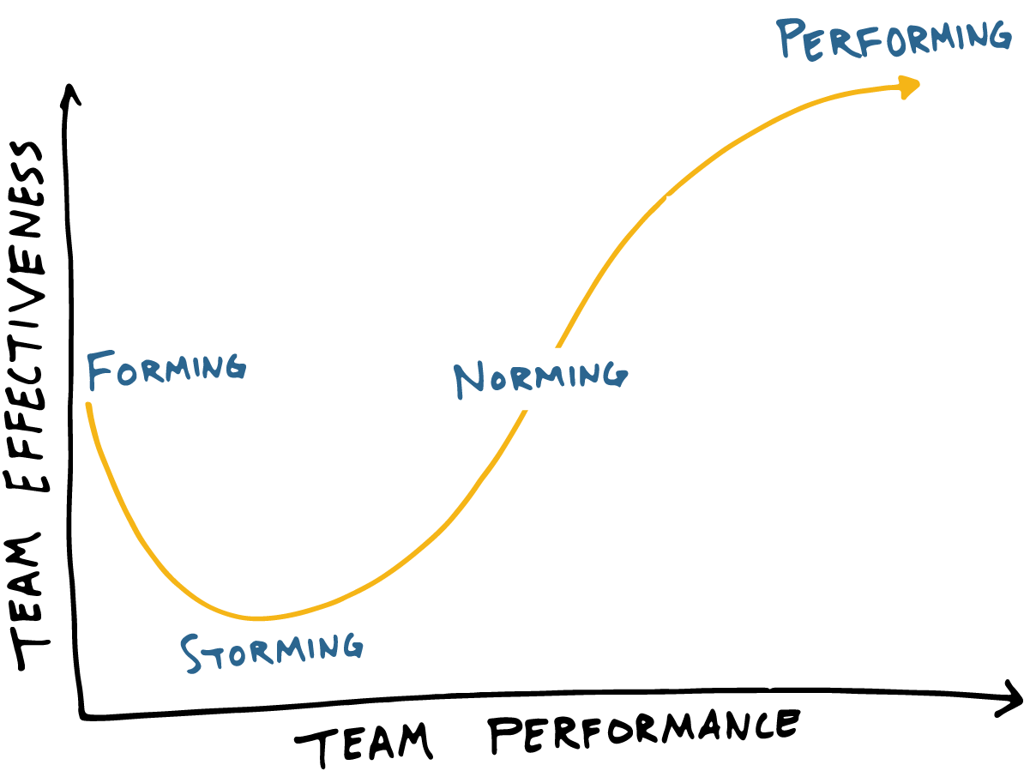


Challenges
First challenge
  Working in a new team
Data Validation/ Credibility Checks Dataset
Over Ambitious Targets
Scope Creep
Time Management
Communication Breakdowns

Slide 8
Issues
Resolution
New Team
  Respecting everyone’s opinion – Diversity
  Strength of each team member was utilized
Identifying Right Dataset
  Brainstorming
  Collaboration
  Discussions
Over Ambitious Targets
  Defining Scope
  Shortlisting of Questions to address
Scope Creep
  Defining and Assigning Tasks
  Project Tracker and monitoring
Time Management
  Progress update meetings
  Flexible schedule
Communication Breakdowns
  Whatsapp Channel

Slide 9
Future Work
MultiRegression
Clustering/ Segmentation Model
Data Enrichment
Exploring more datasources related to retail customers shopping behavior

Slide 10
My Contribution
Every team member contributed at their best
My Strengths
  Technical Experience in Business Intelligence
  Agile Project Management
  Data Visualization
  Business insights

Slide 11

Overall Experience

